Slide 1
Toward Dynamic Grasp Acquisition:
The G-SLAM Problem
Li (Emma) Zhang and Jeff Trinkle
Department of Computer Science, Rensselaer Polytechnic Institute
Notes:
Grasp Acquisition is robot hand approaching the object, locate the fingers around the object and form a grasp on the object.
Grasp acquisition is easy for people, When a human sees a mug, he/she knows immediately how to handle it,
whether empty or full of hot soup. His perception and motor-control systems and years
of experience make it easy for him to grasp the mug and manipulate it. If some aspect of
the mug (for example, its shape) does not meet his expectations, he can explore the mug's
shape with his visual and tactile sensors, and very quickly adapt his manipulation strategy.
Robot grasp acquisition is sensitive to a lot of factors
Localization error, controller error, bump onto the object, Causes the grasp to fail. On the other hand, even when robot is able to form a grasp,object movement caused by the approaching hand and blocked view will Toward solving these problems and aiming at a fully dynamic grasp acquisition, we defined G-SLAM problem . S

Slide 2
G-SLAM Problem
The G-SL(AM)² problem is to autonomous robotic grasping, what the SLAM problem is to autonomous robotic mobility.
The G stands for Grasping. SL(AM)² stands for: Simultaneous Localization, and Modeling, and Manipulation.
Notes:
The word Modeling implies that the robot will use its sensor systems (tactile, visual, and kinesthetic) to build and improve a model of the object. For grasping system, it involves information that is hard to obtain
with sufficient accuracy: a geometric model of the object,
estimates of important physical properties (such as weight
and friction), and the ability to track the pose of the object
and contacts in real-time.
Manipulation" implies that the robot will physically manipulate the object to help accomplish the modeling task.
Localization" implies that the robot will track the pose of the grasped object during manipulation.

Slide 3
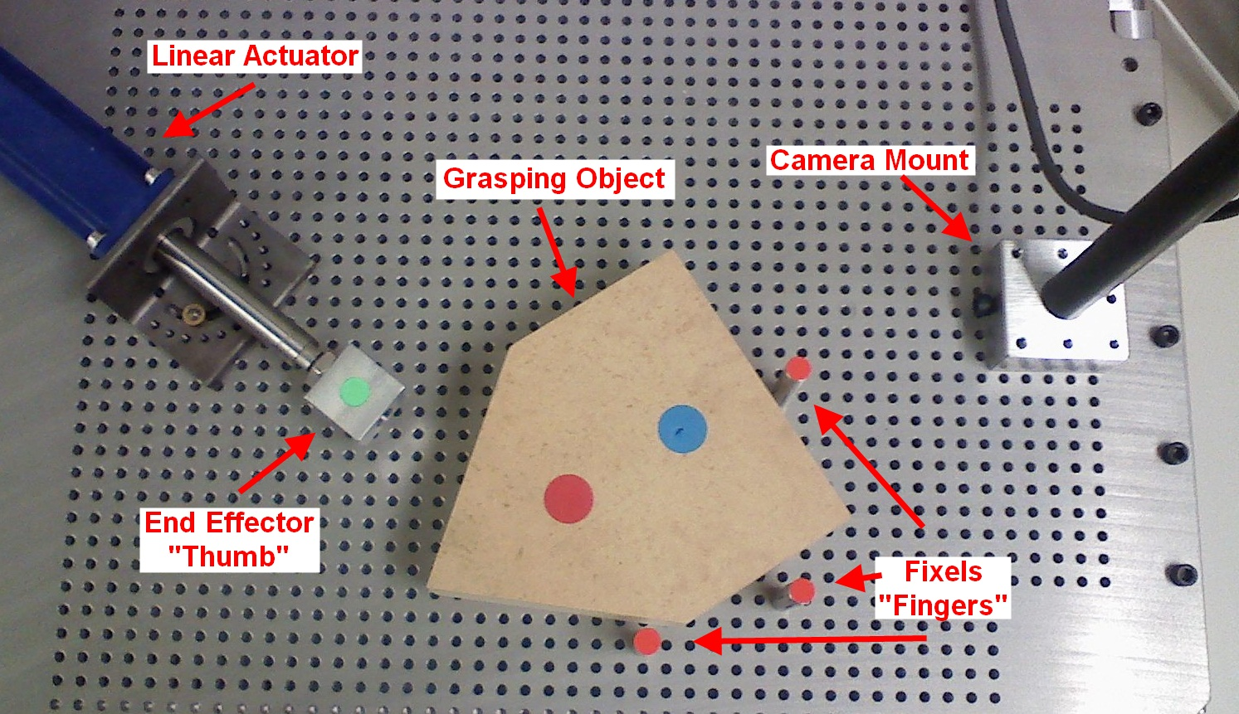
Planar Grasping Testbed
Four model parameters
  Friction coefficients: pusher-obj, fixel-obj, support-obj
  Body-fixed support tripod diameter
+
+
Assumed Support Tripod
+
Notes:
To start the work with a simpler problem, we scaled down the G-SL(AM)2 problem by assuming an accurate geometric model
of the hand, object, and environment
We build this
one linear actuator
and three fixels are mounted on an aluminum plate with
positioning hole array to simulate a one-degree-of-freedom
Hand (Assembly). The moving finger pushes the object toward the other
three fixed fingers to achieve a grasp. As the experiment runs,
frames captured by the overhead camera at 30Hz are post-processed
to extract the configuration of the system, which
will be referred to as “observed data”
The main objective will be to estimate the pose of the object and four parameters of the friction model
of the system
Michael Peshkin & Kevin Lynch used this support tripod to model friction perpendicular to the plane in a quasi-static pushing

Slide 4



Simulation via 2.5D Dynamic Model
Each time-step, PATH solver is used to solve mixed-CP (Complementarity Problem (Linear or Nonlinear))
Newton-Euler Equation
Non-penetration and stick-slip friction behavior can be incorporated by the following Complementarity conditions
Overall
Notes:
Time stepping , current time, next time
The model is composed of the Newton-Euler equation, non-penetration constraints and Coulomb’s Friction Law
where the vector (t; q; ; p) contains distances (obtained from a collision detection algorithm)
between the bodies and relative tangential velocities at the contacts, the vector F
contains unknown constraint forces and slip speed

Slide 5
Particle Filter
Particle Filter are simulation-based Bayesian model estimation techniques given all observation data up to current time
Unlike Kalman filter, Particle filter are general enough to accommodate nonlinear and non-Gaussian system
Involves more computation
For our problem
Track object from inaccurate visual data and synthetic tactile sensor data
Recognize hidden system state, including velocity, friction-related parameters
Notes:
Framework
by Bayesian model, we mean the joint probability distribution of the system state, which might be partially hidden.
Includes the tactile sensor
Due to contact-not, stick-slip ,the nature of multibody dynamics is non-smooth, Particle filter will have much better accommodation

Slide 6

Specific Issues
Non-penetration Constraint
  Direct sampling in the state space generates poor sample with probability 1
Physical parameter constraint
  No dynamics
  Poor Estimate when not impacting
Notes:
In this model, w denotes the process noise and v the observation noise. Here both w and v are mutually independent
distributed sequences with known probability density functions. The functions, f (.) and h(.), are known deterministic
state transition and observation functions.
If we use this form of the system model (by replacing f with Γ), This noise will be
obtained by choosing random rigid body displacements in the ambient state space and added to the solution of the state predicted by the dynamic model of the grasping system.
Physically, this means that in conﬁgurations with contact, many of the particles will
correspond to conﬁgurations in which bodies are overlapping or are separated when they should be touching.
Rejection approach would fail, because lower manifold sample generation will be very ineffective
Parameters do vary with time or as the object moves , but No physically-motivated dynamics for the parameter
System cannot generate useful estimate on the parameter that’s not impacting

Slide 7


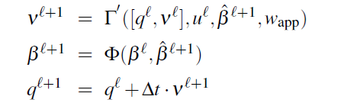
Solution
Noise = Applied Force noise + Parameter noise
  Solutions of the model yield valid particles
Parameters updated only when impacting
Notes:
Instead of simply sampling the state by adding noise to the predicted state,

Slide 8
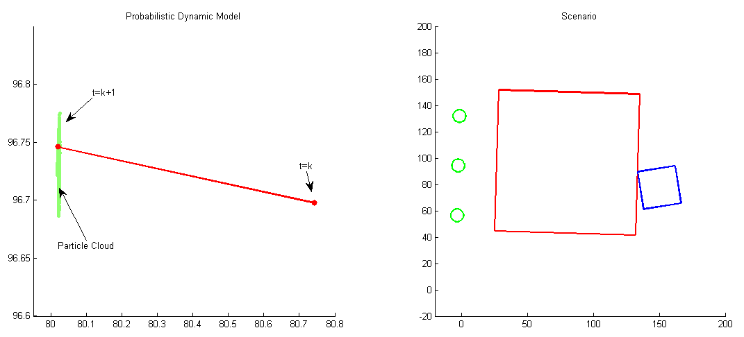
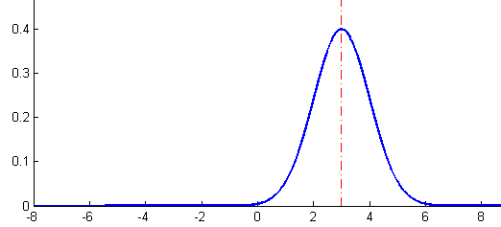
Probabilistic Models
System Dynamic Model
  Centered at Stewart-Trinkle 2.5D time-stepping model
Observation Model
  Assumes Gaussian Distribution centered at observed data
Notes:
The first is the system dynamic model. Right image shows the starting scene of the work space. Left image shows the dynamic model during one time step. The red dot with t=k denotes the current position of the object, while the other red dot is for the position at next time step from the deterministic model.
the green point cloud represents possible output of the dynamic model when noises are introduced. Each point in the pointcloud corresponds to a valid
The second model is the perceptual model. It’s the probability that we have certain observations when the system is in a particular state. As in our case, vision detection on camera image will return us the observation result synthetic tactile sensor will give us the binary contact information on the fixels,for the camera data which should be slightly noised about the real position. So a normal distribution centered at system state is adopted here.

Slide 9
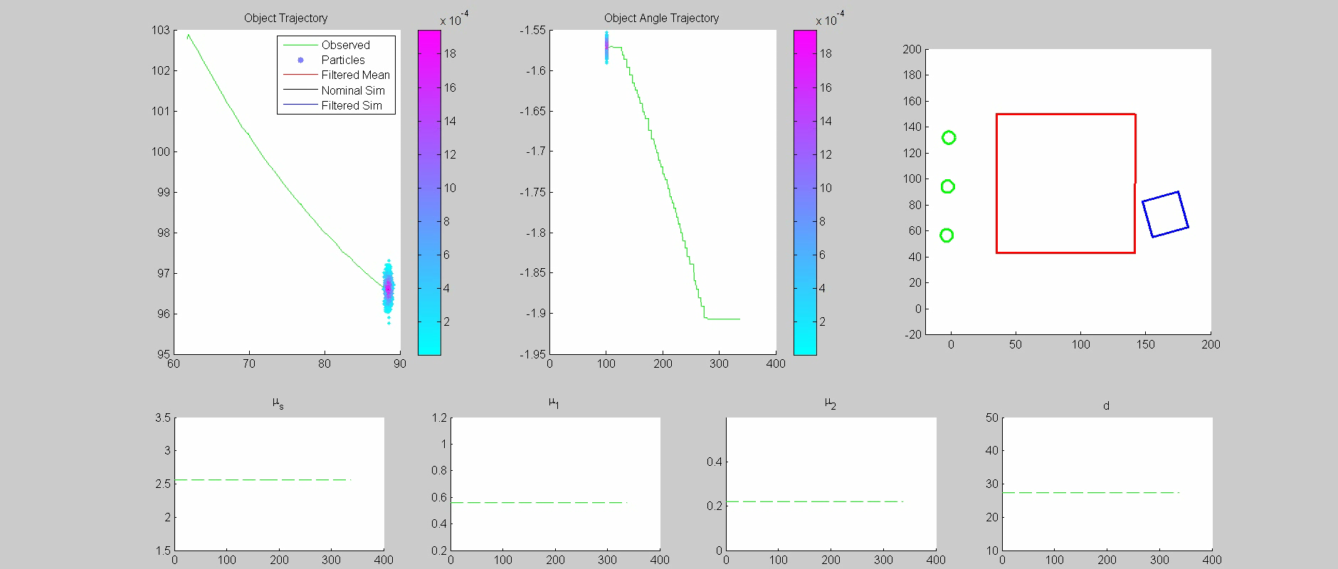
Demo 1: A Typical Experiment
Notes:
This demo is from using particle filter in one of our planar grasping experiment.
Talk about the green curve, point cloud, introduce more before the video begins. Describe what will happen in the video.
The top videos show the filtering process and estimated scenario. And the bottom row is about estimating the parameters. These blue dots are hypothesis of where the object is. The color of the dots denote their weights. Red means higher weight, while blue means low weight. As the process goes on, the particle filter algorithm keeps deciding which particles are more likely to be the exact object’s position based on the dynamic model and observation data
You may notice that before the actuator actually touches the object, particles were all centered about the starting position.
The black line represents the nominal simulated trajectory. This is from simulating the whole process using our calibrated parameter. This is a well calibrated experiment, which means the calibrated parameter matches the experiment well. Red line invisible close to the observed trajectory, is the filtered result. But we still can see that the filtered trajectory is closer to the observed data. And we can see that the parameters differ from the calibrated parameter.

Slide 10
Particle Filter – Algorithm
To start:
  sample from initial probability density function
Prediction
  Each particle calculate its own state at the next time step using the system dynamic model, noise added
Update:
  Each particle’s weight is multiplied by the likelihood of getting the sensor readings from that particle’s hypothesis
Resample
  new set of particles are chosen such that each particle survives in proportion to its weight, and all weights are restored to equal
  Not necessarily happen every time step
Notes:
To start the algorithm, we need the initial belief state, which is our initial guess of the state pdf. for object tracking, particle sampled around the starting camera observation
During the update step, we take the sensor measurements and times each particle a weight that is equal to the probability of observing the sensor measurements from that particle’s state. Those weights are then normalized so that they sum to 1. In the video, we can see that particles’weights are changing, which mainly comes from this process
Finally, in the resample step, as you can see on the picture, the weighted cloud of particles turns into somewhat more condensed cloud of un-weighted particles on the right. The highly unlikely particles at the fringe are not chosen and high weighted particles near the center are replicated so they are more densed in the center, aiming at correctly representing the posterior distribution

Slide 11
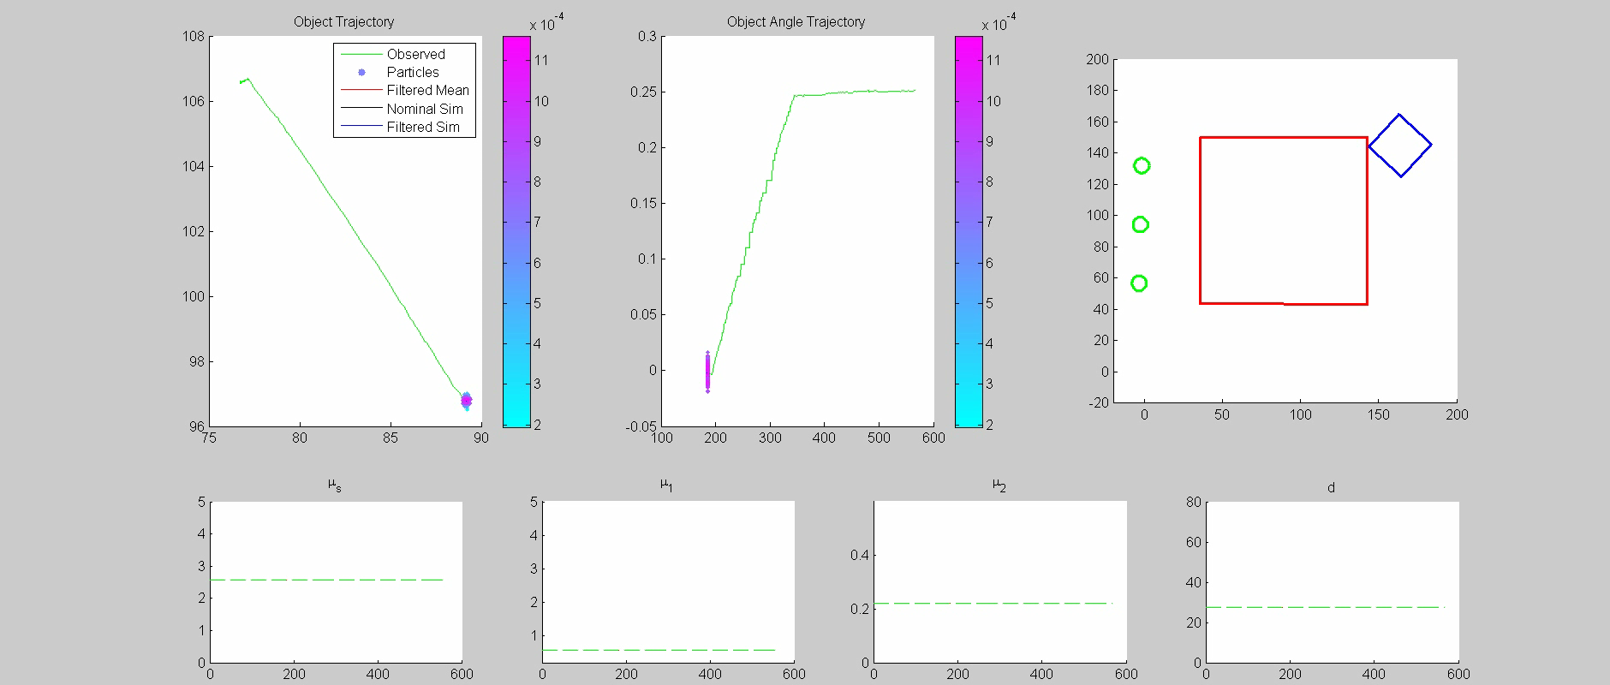
Demo 2: A Parameter Calibration Outlier
Notes:
This is from applying particle filter to one of our calibration outlier experiment. It suggests that the simulation using the calibrated parameter diverge from the experiment observation. A possible explanation is as the object have a different trajectory on the bumpy plate and thereby the friction coefficients are different from other experiments.
From the right video, one can see that the estimated parameter this time differs from the starting parameter quite much. And the filtered trajectory are much closer to the experiment than corresponding nominal simulation.

Slide 12
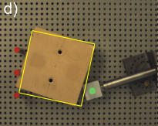
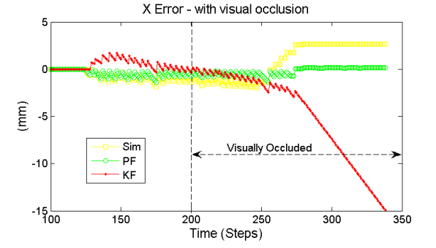
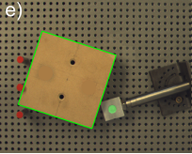
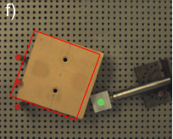
Comparison with Kalman Filter
Notes:
This plot shows the comparison result
X axis and y axis, other coordinate similar
Visual blackout
During a visual blackout, the particle ﬁlter updated all particles using the
system transition model without updating the particle weights
or introducing parameter noise. As a result, the friction
parameters did not change after this time
The right column of images
show the filtered final grasp conﬁgurations overlaid on an
image of the real system.

Slide 13
Future Work
Expand the system state to include geometry model
Extend to 3-d system
Faster computation speed

Slide 14
Questions?
Thanks!

Slide 15
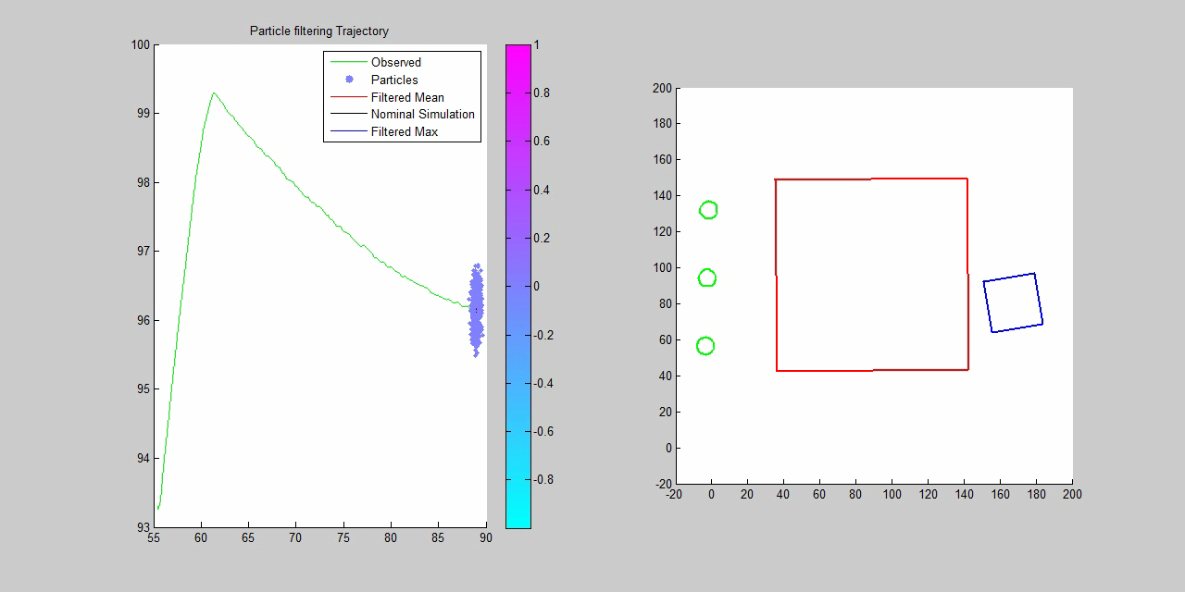
Specific Difficulties
Real-Time issue
Particle Impoverishment near frictional form closure
Notes:
Real-time issue. The However, processing a
pre-collected 20-second experiment currently requires 10
minutes of cpu time on a i7-core desktop PC
A second problem is from particle impoverishment near frictional form closure. We can watch this video for example. Very few particles can transit to the higher constrained state, which leads to the particle impoverishment.

Slide 16
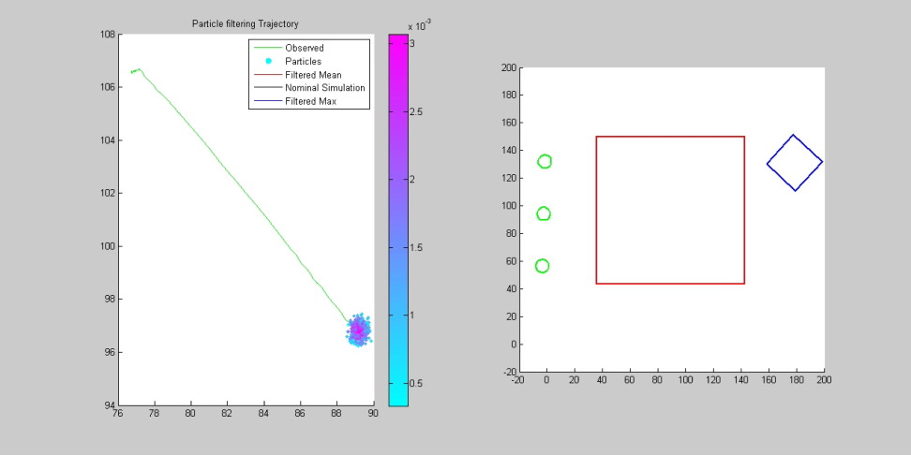
Why Resample?
If you keep old particles around without resampling:
  Particle impoverishment
  Areas with high probability in posterior not represented well
  Density of particles doesn’t represent pdf
Notes:
So, just to make clear why it is necessary to resample the particles:
If you just keep your old particles around forever without resampling them, what happens is that your particles drift around according to the dynamics model (transition probabilities for the next time step), but other than their weights, they are unaffected by your observations. Highly unlikely particles will be kept around and transitioned to more unlikely states, and you might only have say, one particle in the area of high probability of your posterior.
So what you end up with is one particle with a way higher likelihood than any of the other particles, and a whole lot of particles with almost-nil probability. This is what we call ‘particle impoverishment’, because we in effect have only one particle. And one particle doesn’t represent a pdf very well.
This video will show this phenomenon pretty well.
And so you have to resample the particles, so that they continue to represent the pdf accurately and keep track of many high-probability hypotheses, instead of tracking lots of useless, low-probability hypotheses.

